Slide 1

Factor befitting for insurance charges ALY 6015 – INTERMEDIATE ANALYTICS CRN - 21011 Instructor-Valeriy Shevchenko
SHIVI NIGAM | nigam.sh@husky.neu.edu
MIHIR GANDHI | gandhi.mih@husky.neu.edu
MAHITA KODURU | koduru.m@husky.neu.edu
RUCHI PARAB | parab.r@husky.neu.edu
Date of Submission : 02/14/2019

Slide 2
What does this model DO?
Identify the influence of each factor on cost of the insurance.
Checking the accuracy of the cost.

Slide 3
Statistics of the health insurance in USA
Insurance industry at-a-glance. U.S. insurance industry net premiums written totaled$1.2 trillion in 2017, with premiums recorded by life/health (L/H) insurers accounting for 52 percent
01
The uninsured rate decreased between 2015 and 2016 by 0.3 percentage points as measured by the CPS ASEC. In 2016, the per­centage of people without health insurance coverage for the entire calendar year was 8.8 percent, or 28.1 million, lower than the rate and number of uninsured in 2015 (9.1 percent or 29.0 million).
02

Slide 4
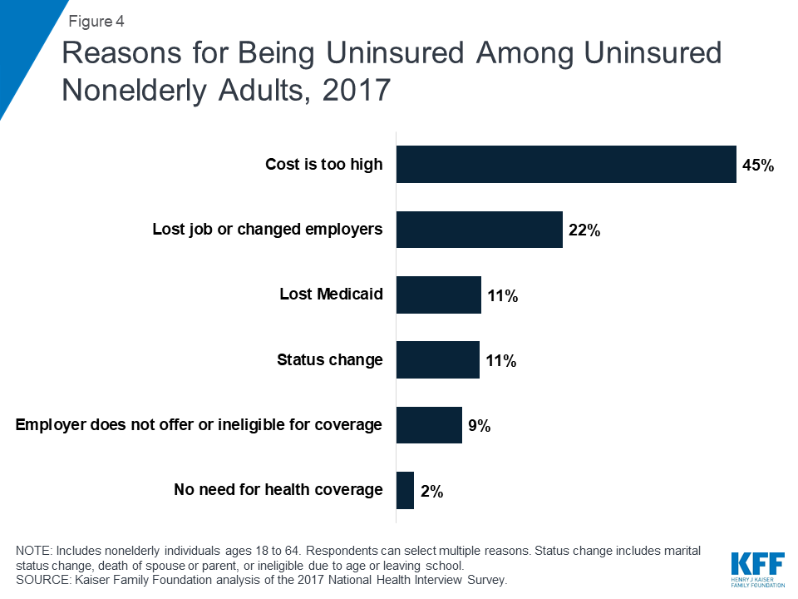
Reasons for being uninsured
Cost still poses a major barrier to coverage for the uninsured.
In 2017, 45% of uninsured nonelderly adults said they were uninsured because the cost is too high, making it the most common reason cited for being uninsured

Slide 5
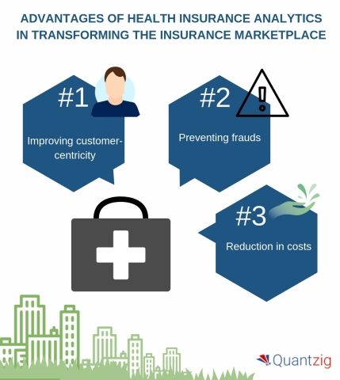
Analyzing the impact of health insurance analytics

Slide 6
Improve customer-centricity
make improvements to streamline the process for customers
Preventing frauds
helps in preventing misuse of insurance claims and safeguards companies from losing money
Reduction in costs
making efficient models will result in lower costs and minimize the risk factor which will in turn result in cost reduction

Slide 7

AS AN ANALYST WHAT CAN WE DO?
With the help of REGRESSION ANALYSIS, we have envisioned the optimization and efficiency boosting for the health insurance system.
To incorporate machine learning and health insurance sector we will create a Linear Regression Model.

Slide 8
WHAT IS LINEAR REGRESSION?
Linear Regression is a method of modelling a target value based on independent predictors.
This method is mostly used for forecasting and finding out cause and effect relationship between variables
Regression techniques mostly differ based on the number of independent variables and the type of relationship between the independent and dependent variables

Slide 9
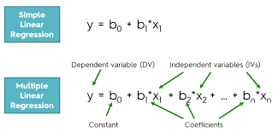
WHAT IS LINEAR REGRESSION?[2]
MATHEMATICAL DIFFERENCE –
Multiple Linear Regression the most common form of linear regression analysis.
As a predictive analysis, the multiple linear regression is used to explain the relationship between one continuous dependent variable and two or more independent variables.
The independent variables can be continuous or categorical.
In this scenario, we will be using multiple linear regression algorithm because we have more than one predictor variables.

Slide 10
ASSUMPTIONS FOR LINEAR REGRESSION [1]
There should be a linear and additive relationship between dependent (response) variable and independent (predictor) variable(s). → Test by plotting a residual vs Fitted value plot.
There should be no correlation between the residual (error) terms. Absence of this phenomenon is known as Autocorrelation → Durbin Watson statistics test
Notes:
A linear relationship suggests that a change in response Y due to one unit change in X¹ is constant, regardless of the value of X¹. An additive relationship suggests that the effect of X¹ on Y is independent of other variables

Slide 11
ASSUMPTIONS FOR LINEAR REGRESSION [2]
The independent variables should not be correlated. Absence of this phenomenon is known as multicollinearity → plot a scatter plot to visualize the correlations / VIF factors .
Heteroskedasticity, presence of outliers or extreme leverage values → Breusch-Pagan / Cook – Weisberg test or White general test to detect this phenomenon.

Slide 12
VARIABLES OF THE DATASET
DEPENDENT VARIABLE
SEX
BMI
There are 7 variables
AGE
CHARGES
CHILDREN
REGION
SMOKER

Slide 13
DESCRIPTION OF THE VARIABLES[1]
We have 6 predictor variables and 1 dependent variable
Age: age of primary beneficiary.
Sex: insurance contractor gender, female, male.
BMI: Body mass index, providing an understanding of body, weights that are relatively high or low relative to height, objective index of body weight (kg/m^2) using the ratio of height to weight, ideally 18.5 to 24.9

Slide 14
DESCRIPTION OF THE VARIABLES[2]
Children: Number of children covered by health insurance/Number of dependents.
Smoker: Is the person a smoker or not.
Region: the beneficiary’s residential area in the US, northeast, southeast, southwest, northwest.
Charges: Individual medical costs billed by health insurance.

Slide 15
Initializing and Libraries
Read dataset with 1338 observations and 7 variables
Libraries:
1. “ggplot2” – for plotting the graphs, data visualization
2. “MASS” – to calculate residuals
3. “lmtest” – testing linear regression models
4. “car” – for applied regression

Slide 16
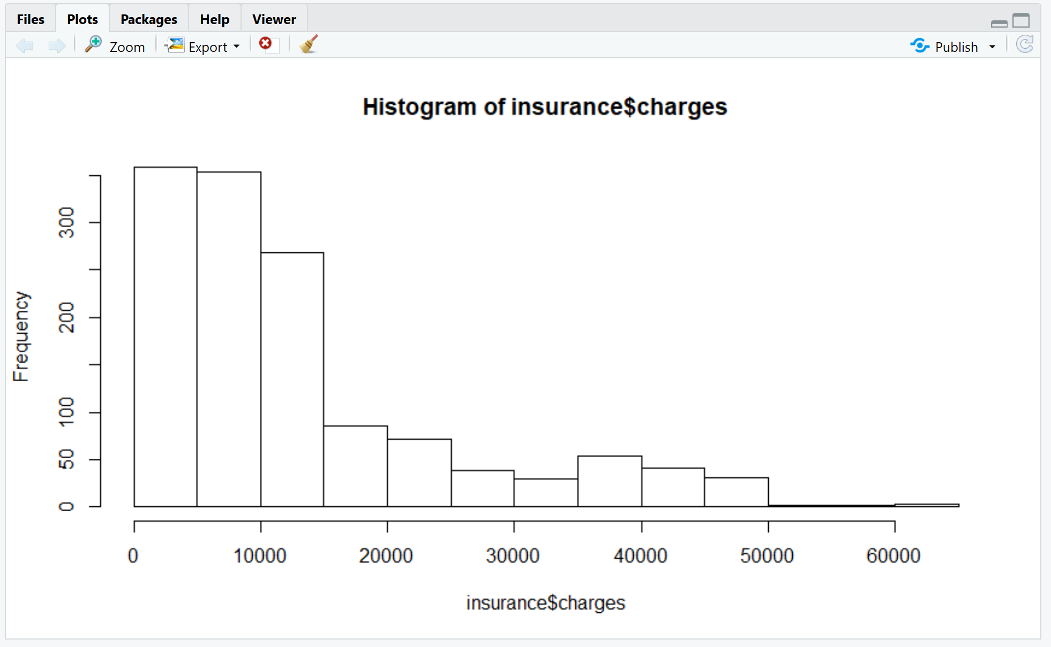
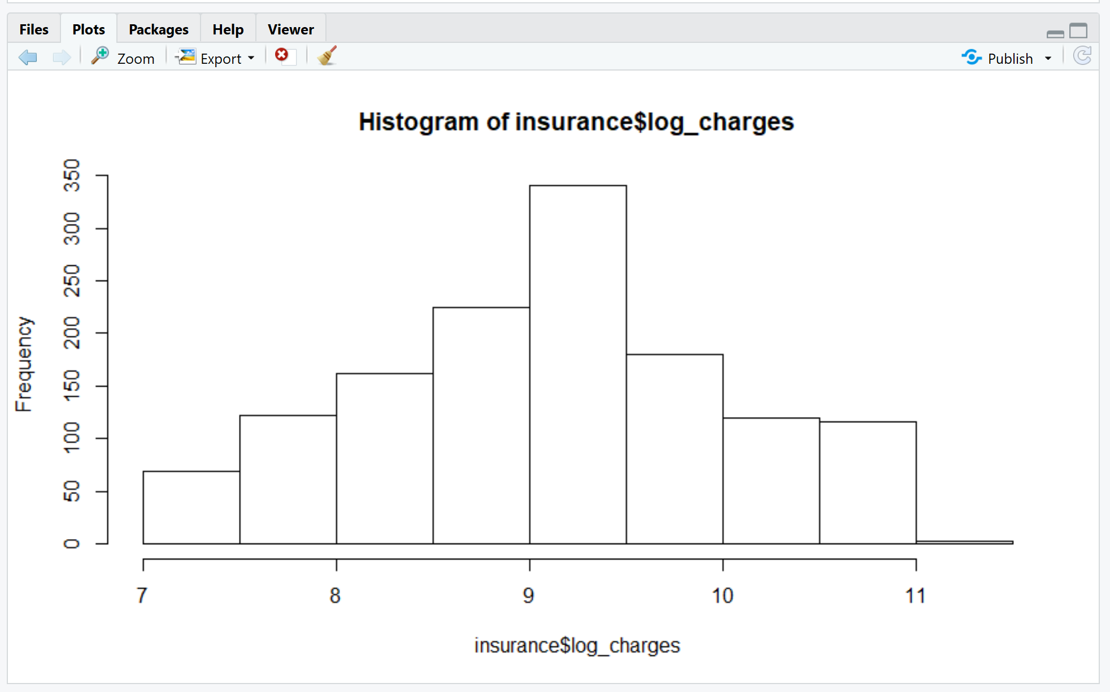
Checking normality
Log Transformation

Slide 17
Creating a linear model and RMSE
Create
Create train model
Output
Output: 1063 out of 1338 observations
Create
Create test model
Output
Output: 268 out of 1338 observations
Predict
Predict the model
Calculate
Calculate RMSE
Output
0.4330 (lower the RMSE better the fit)

Slide 18
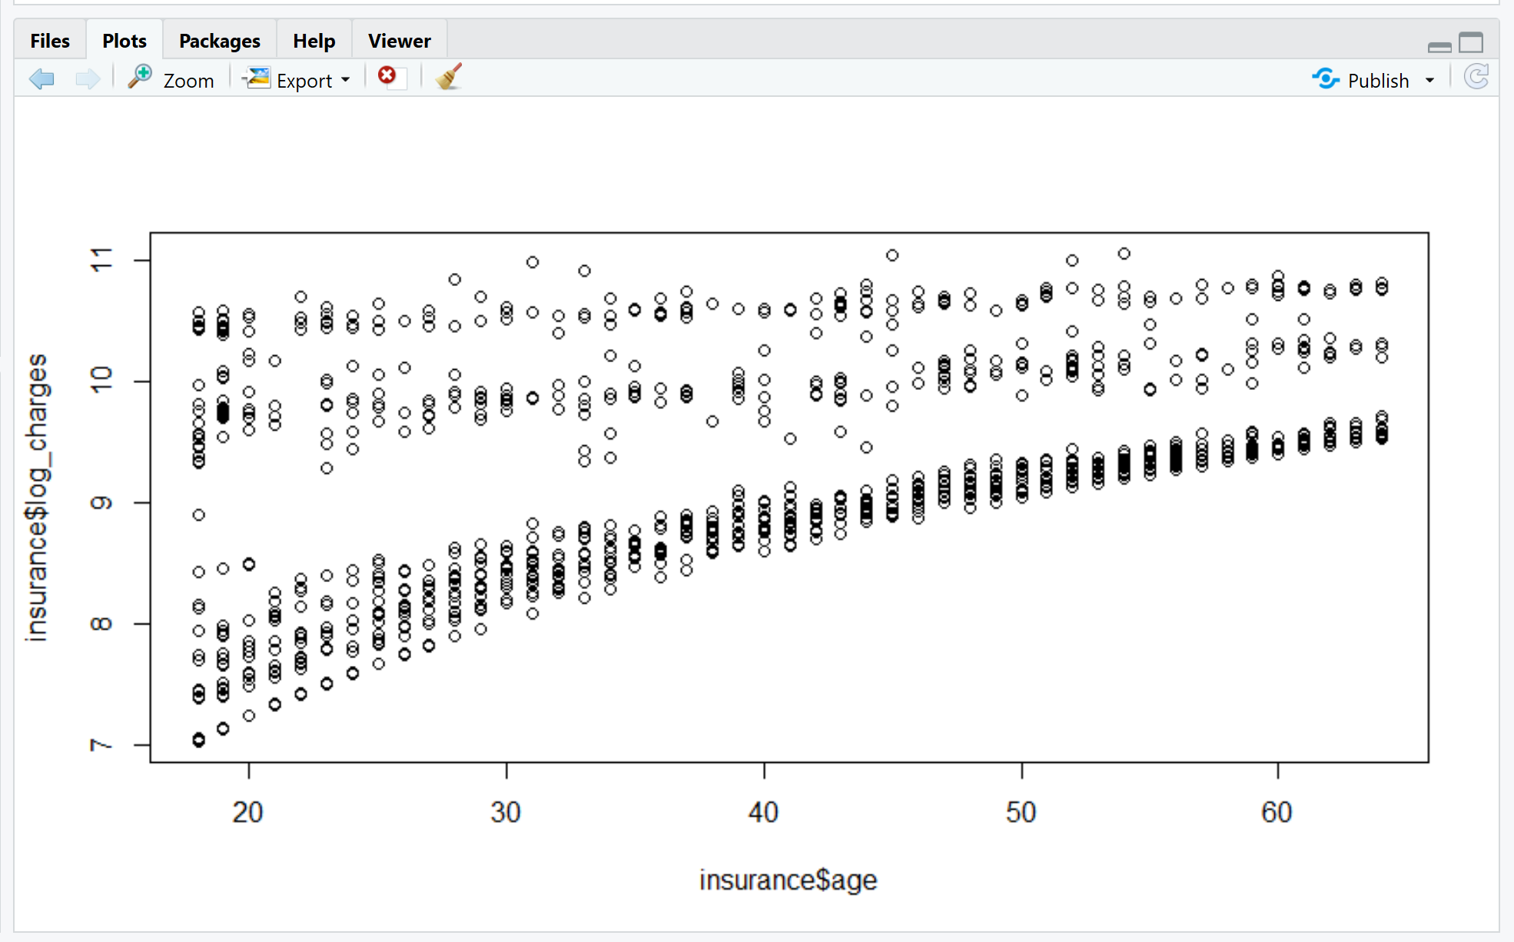
Checking Linearity and Multicollinearity
Multicollinearity with target variables age and BMI:
Value : 0.1092
Not highly correlated

Slide 19
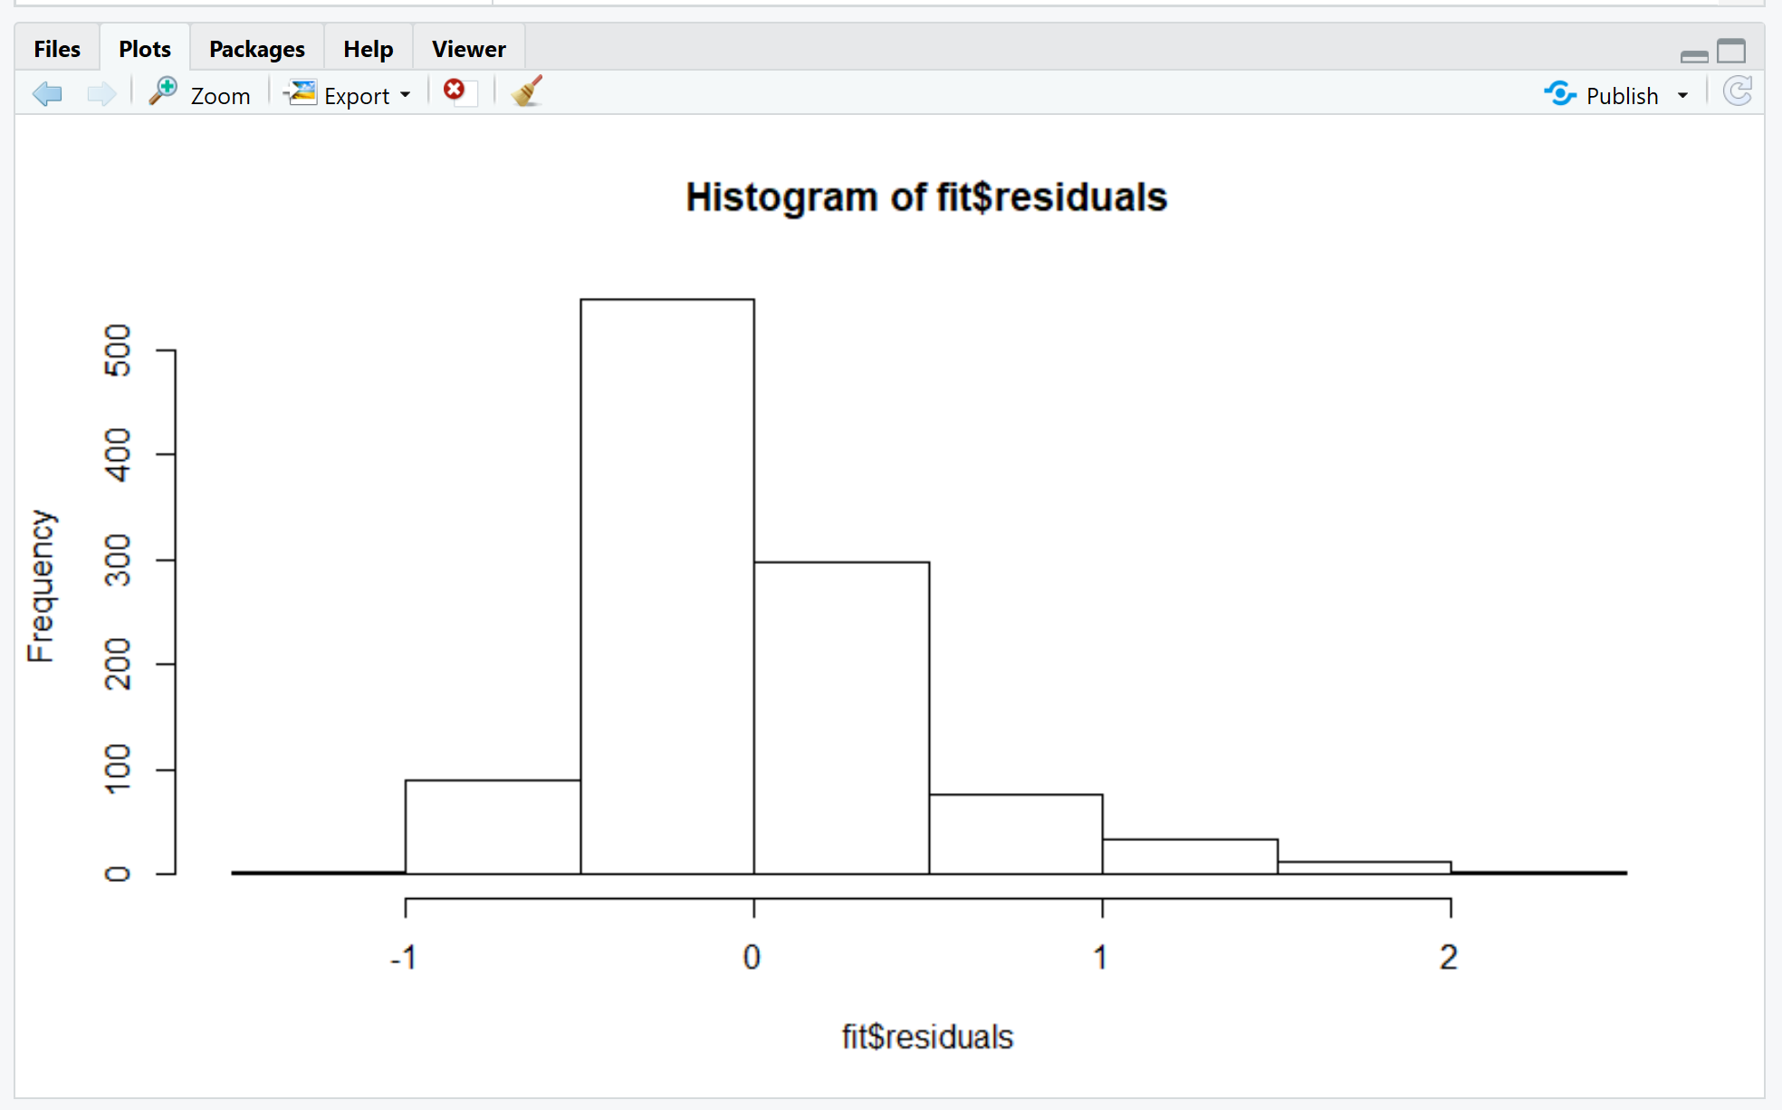
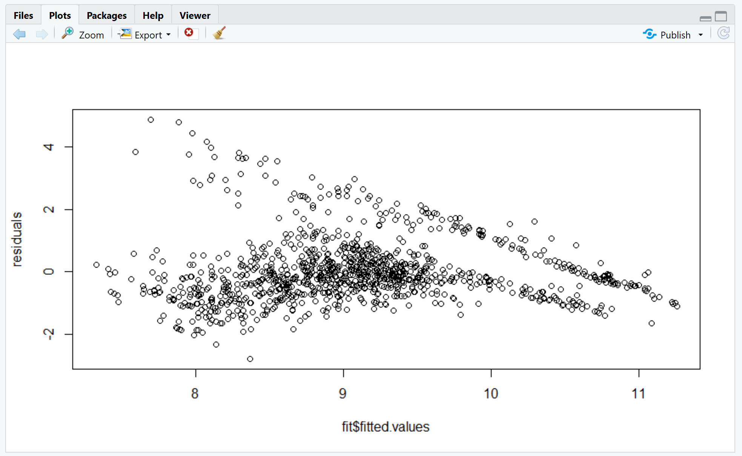
Residuals
Mean of the residuals = -0.000002
Median of the residuals = -0.15
Good fit to the model as
variation of data is less

Slide 20
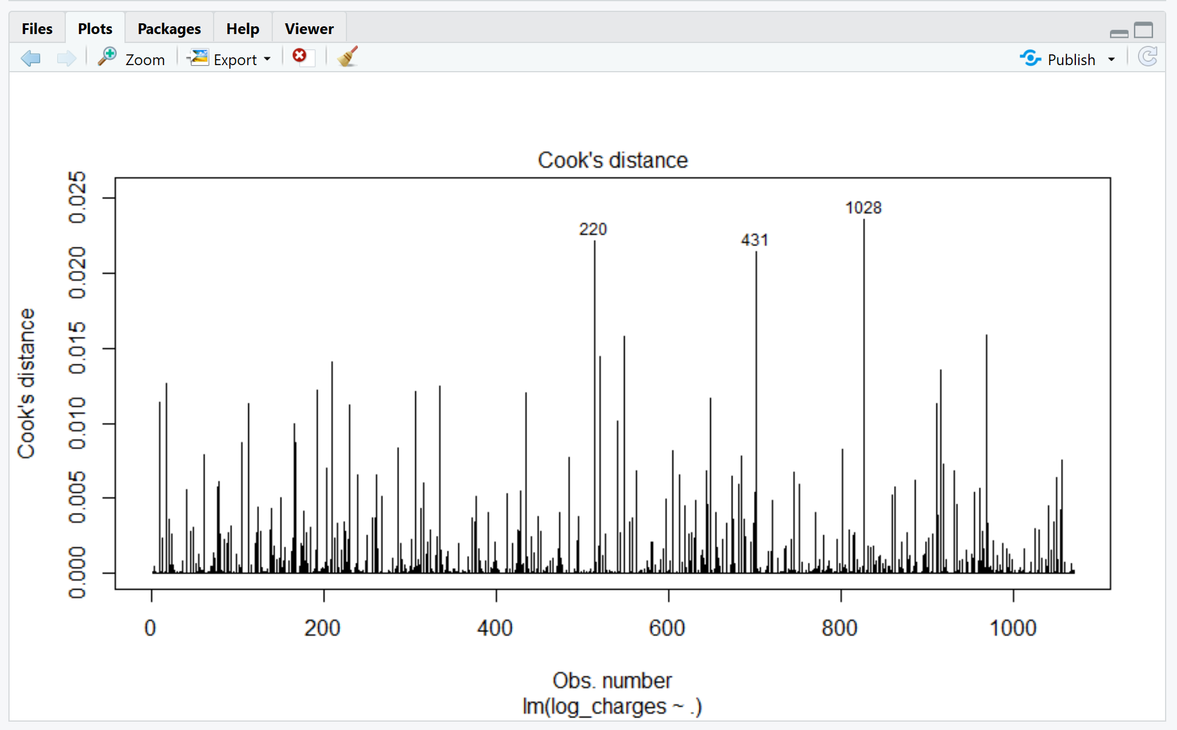
Outliers test
Using Cook’s distance to measure outliers
Observation more than 3 times the cook’s distance is considered an outlier.
Outliers obtained and eliminated:
- 431, 220, 1028, 1040, 103, 527
and 1020.

Slide 21
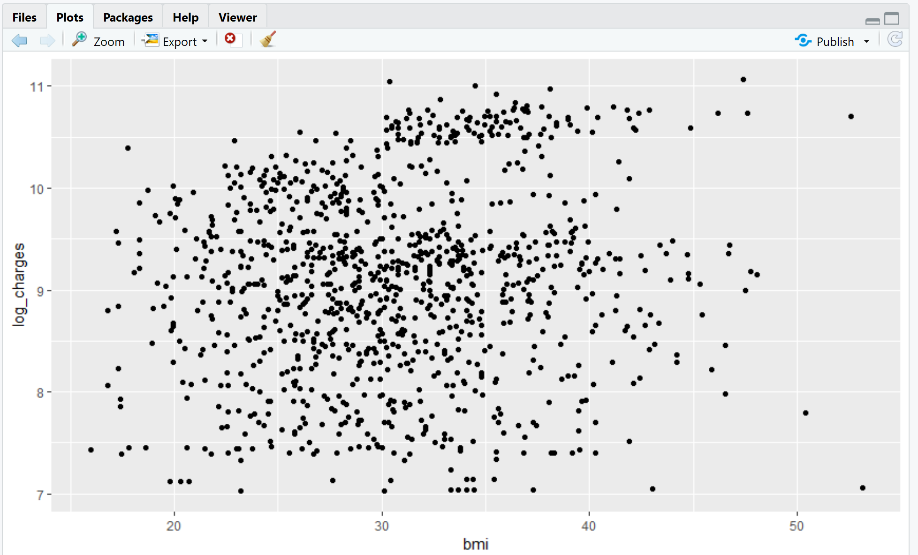
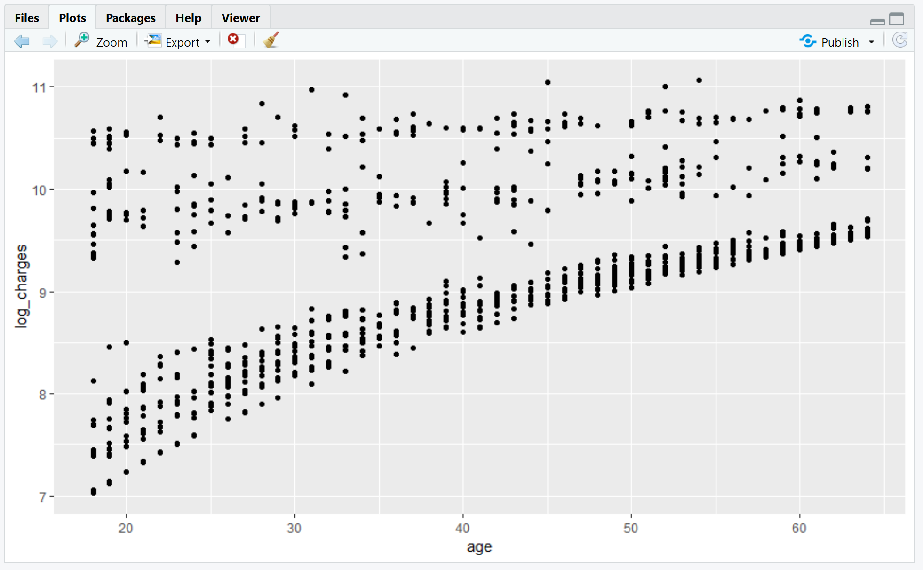
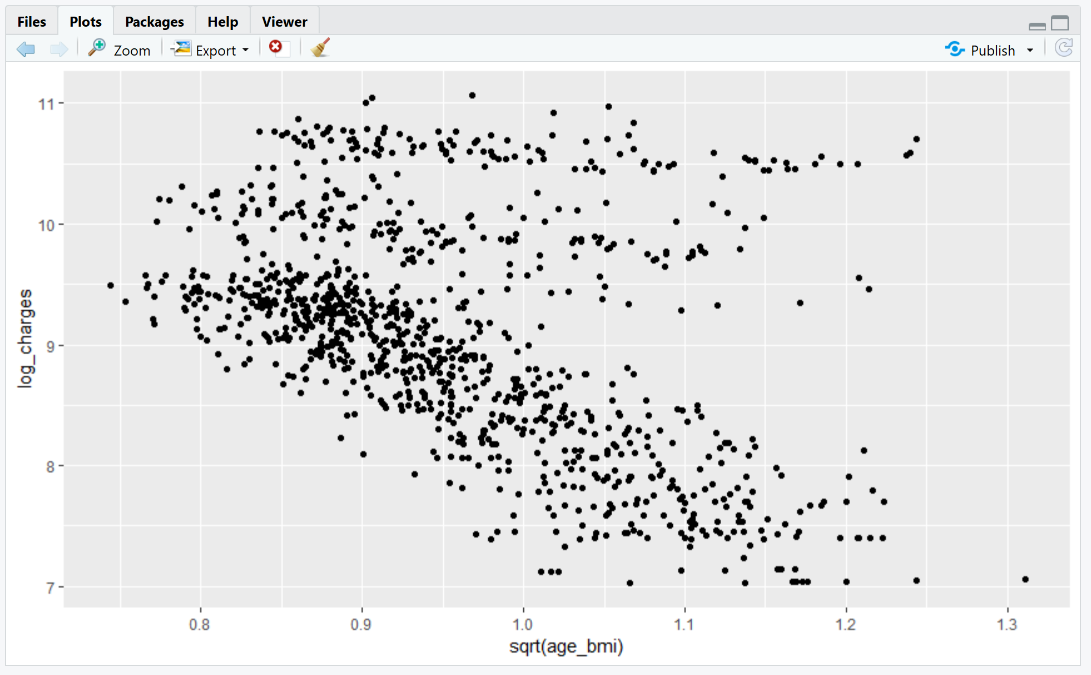
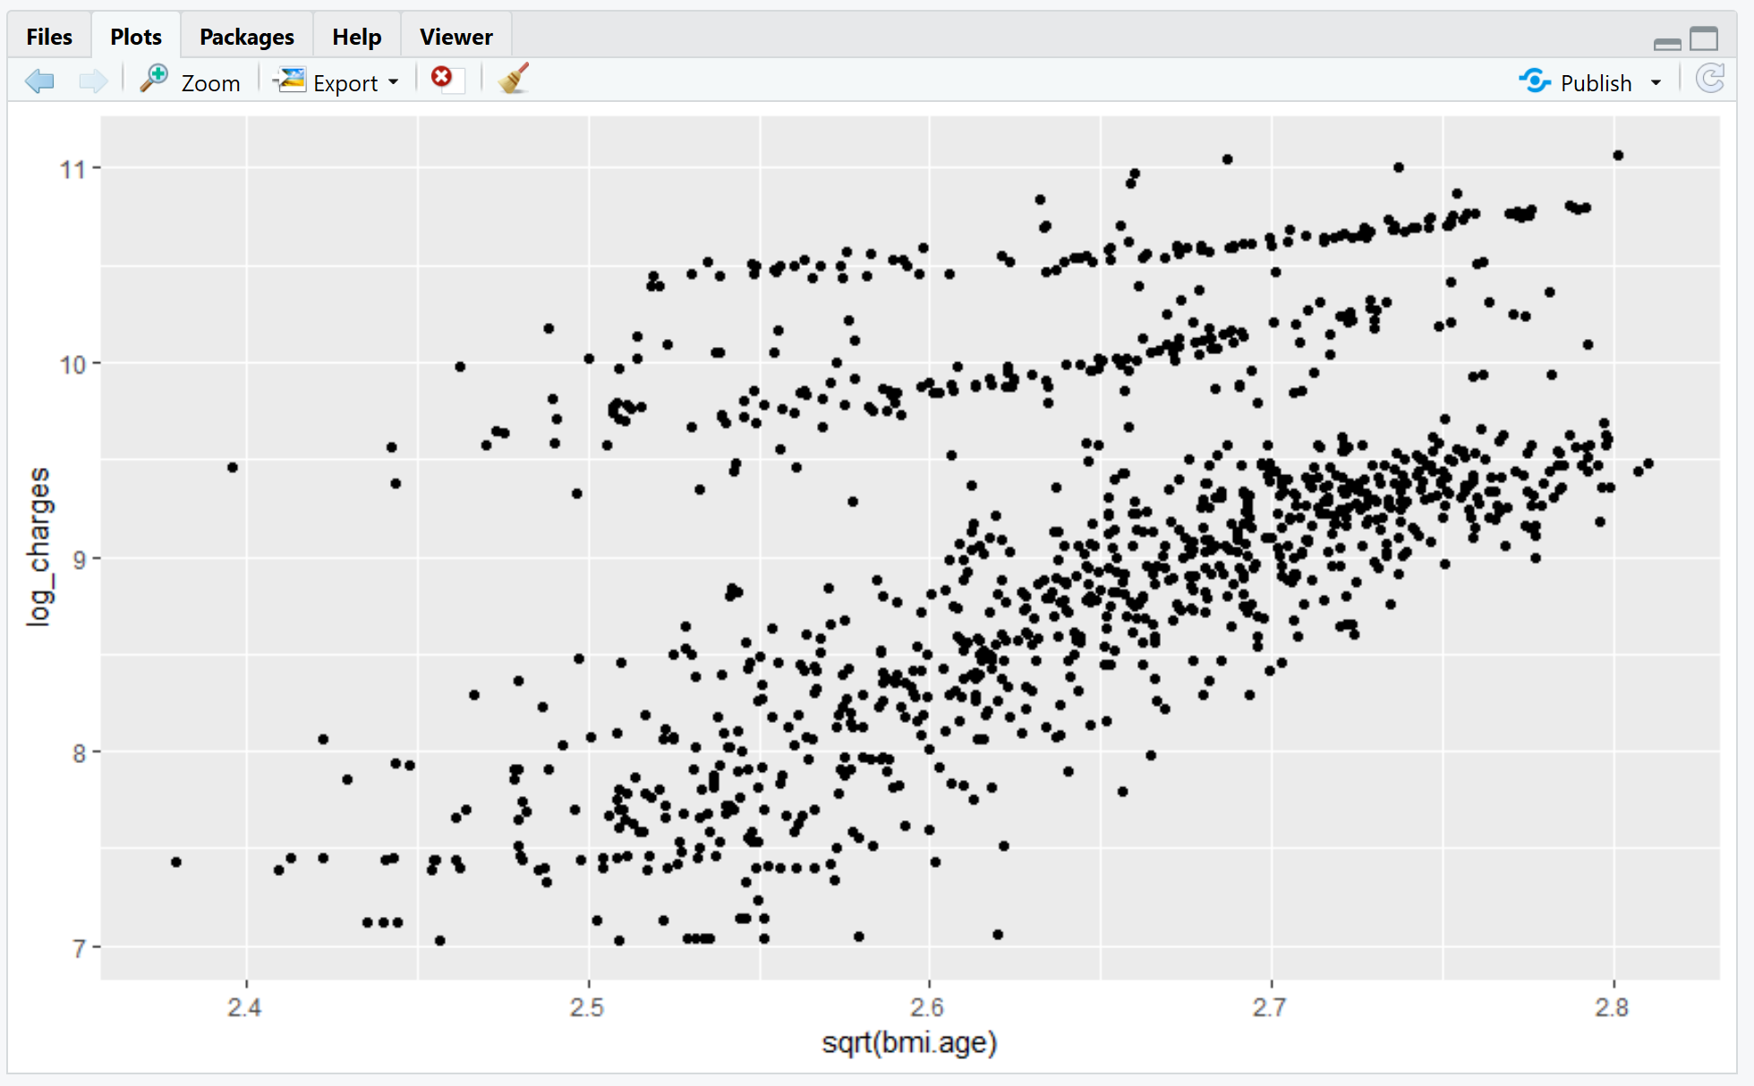
Solving for multi collinearity of Age and BMI - Train
BMI v/s insurance charge
Age v/s insurance charge
Taking square root of age and BMI
Multiplying age and BMI

Slide 22
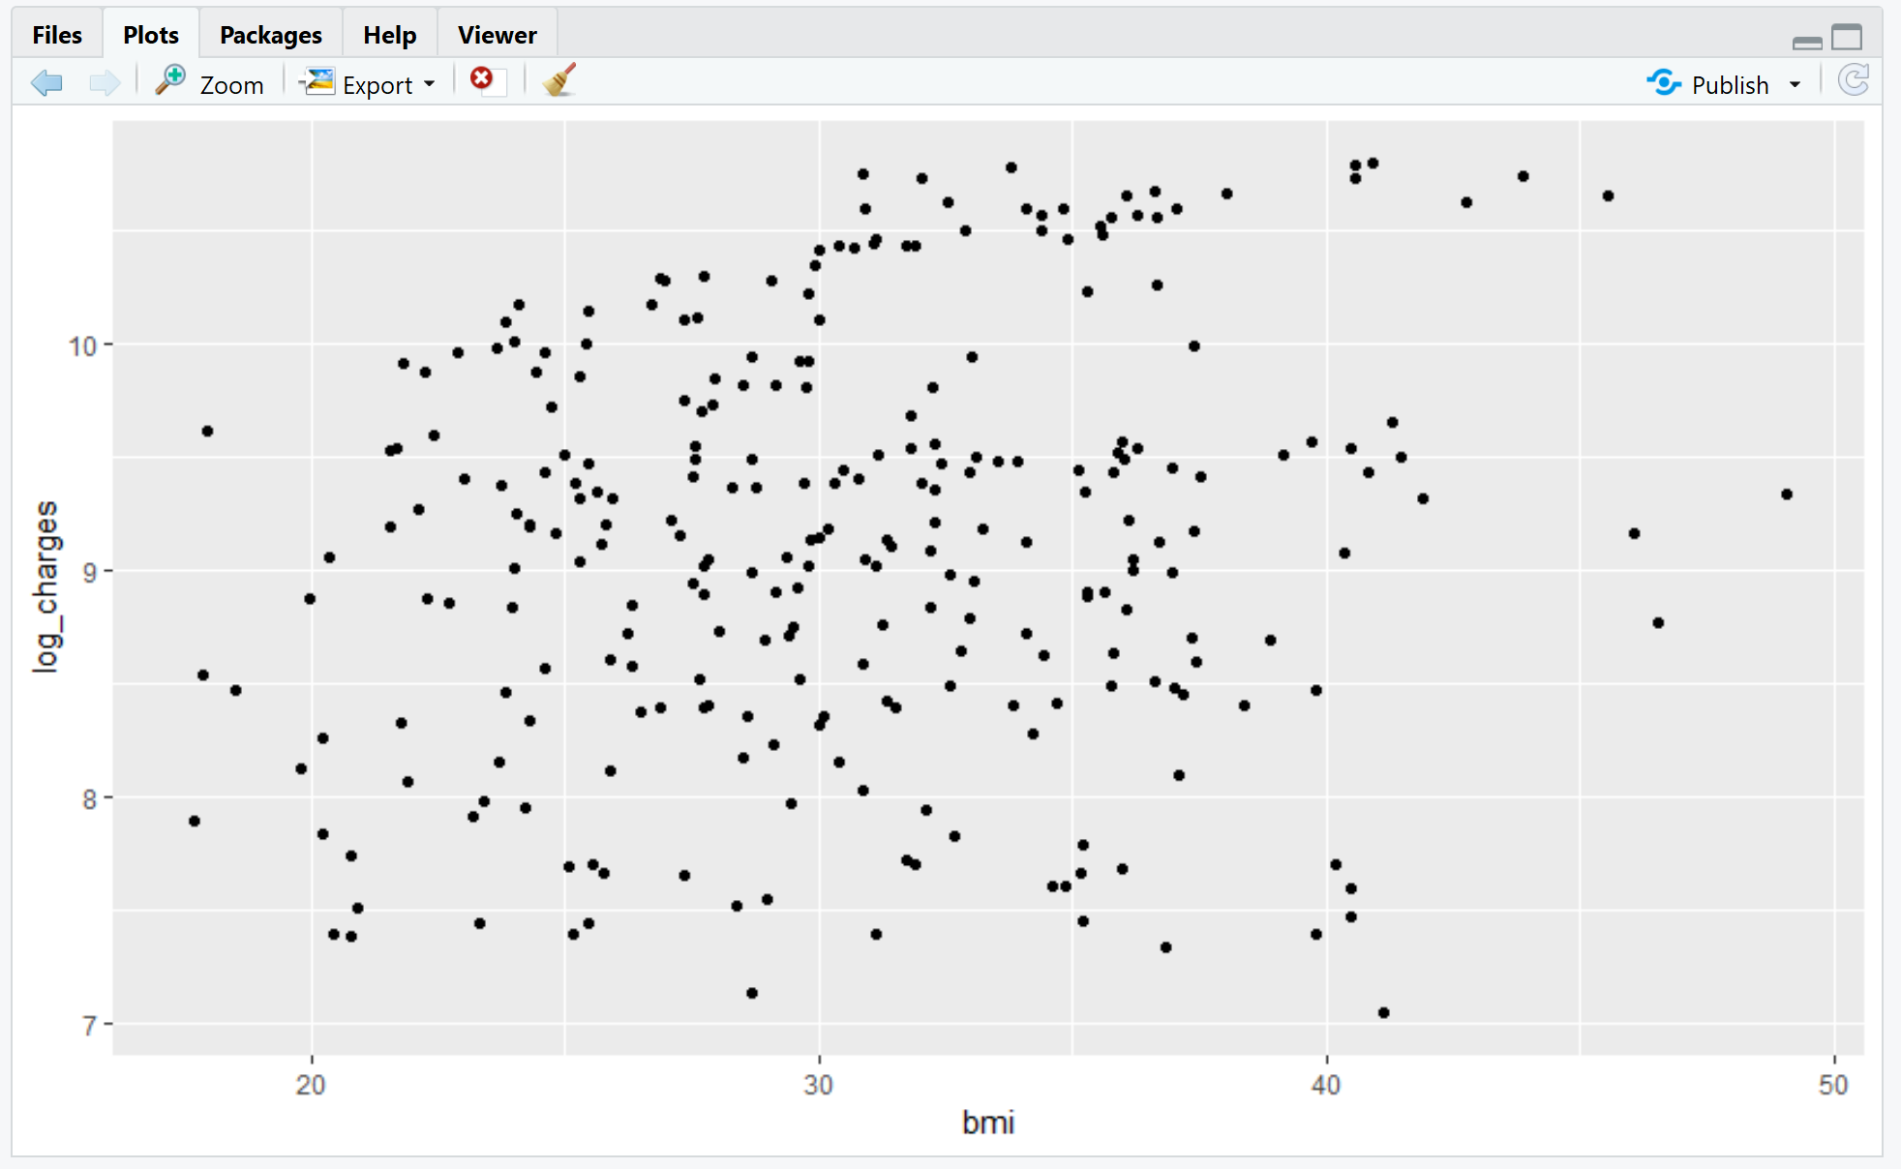
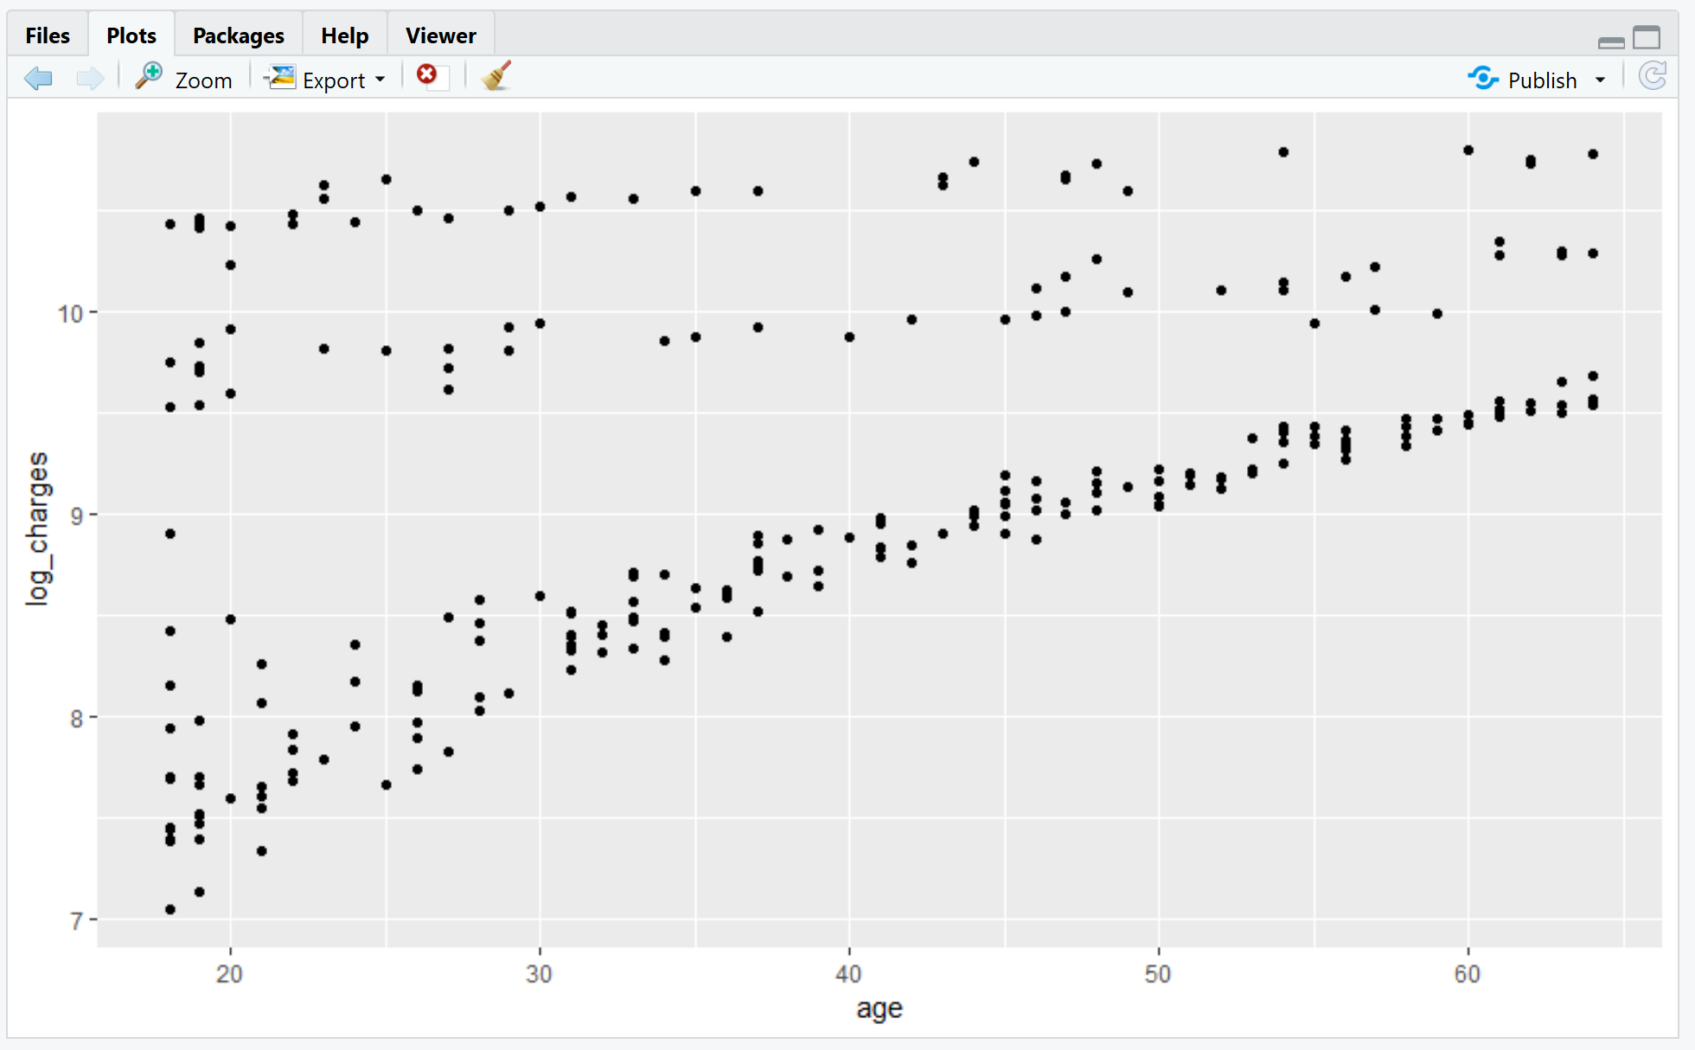
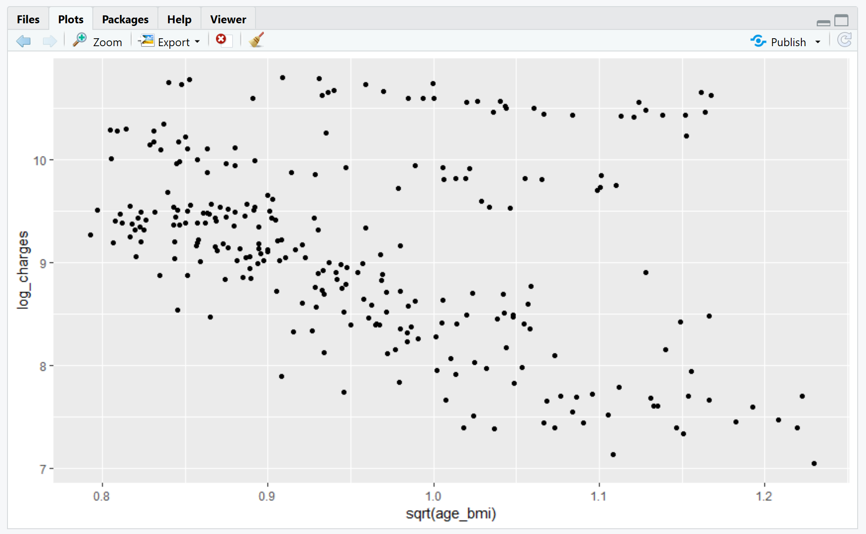
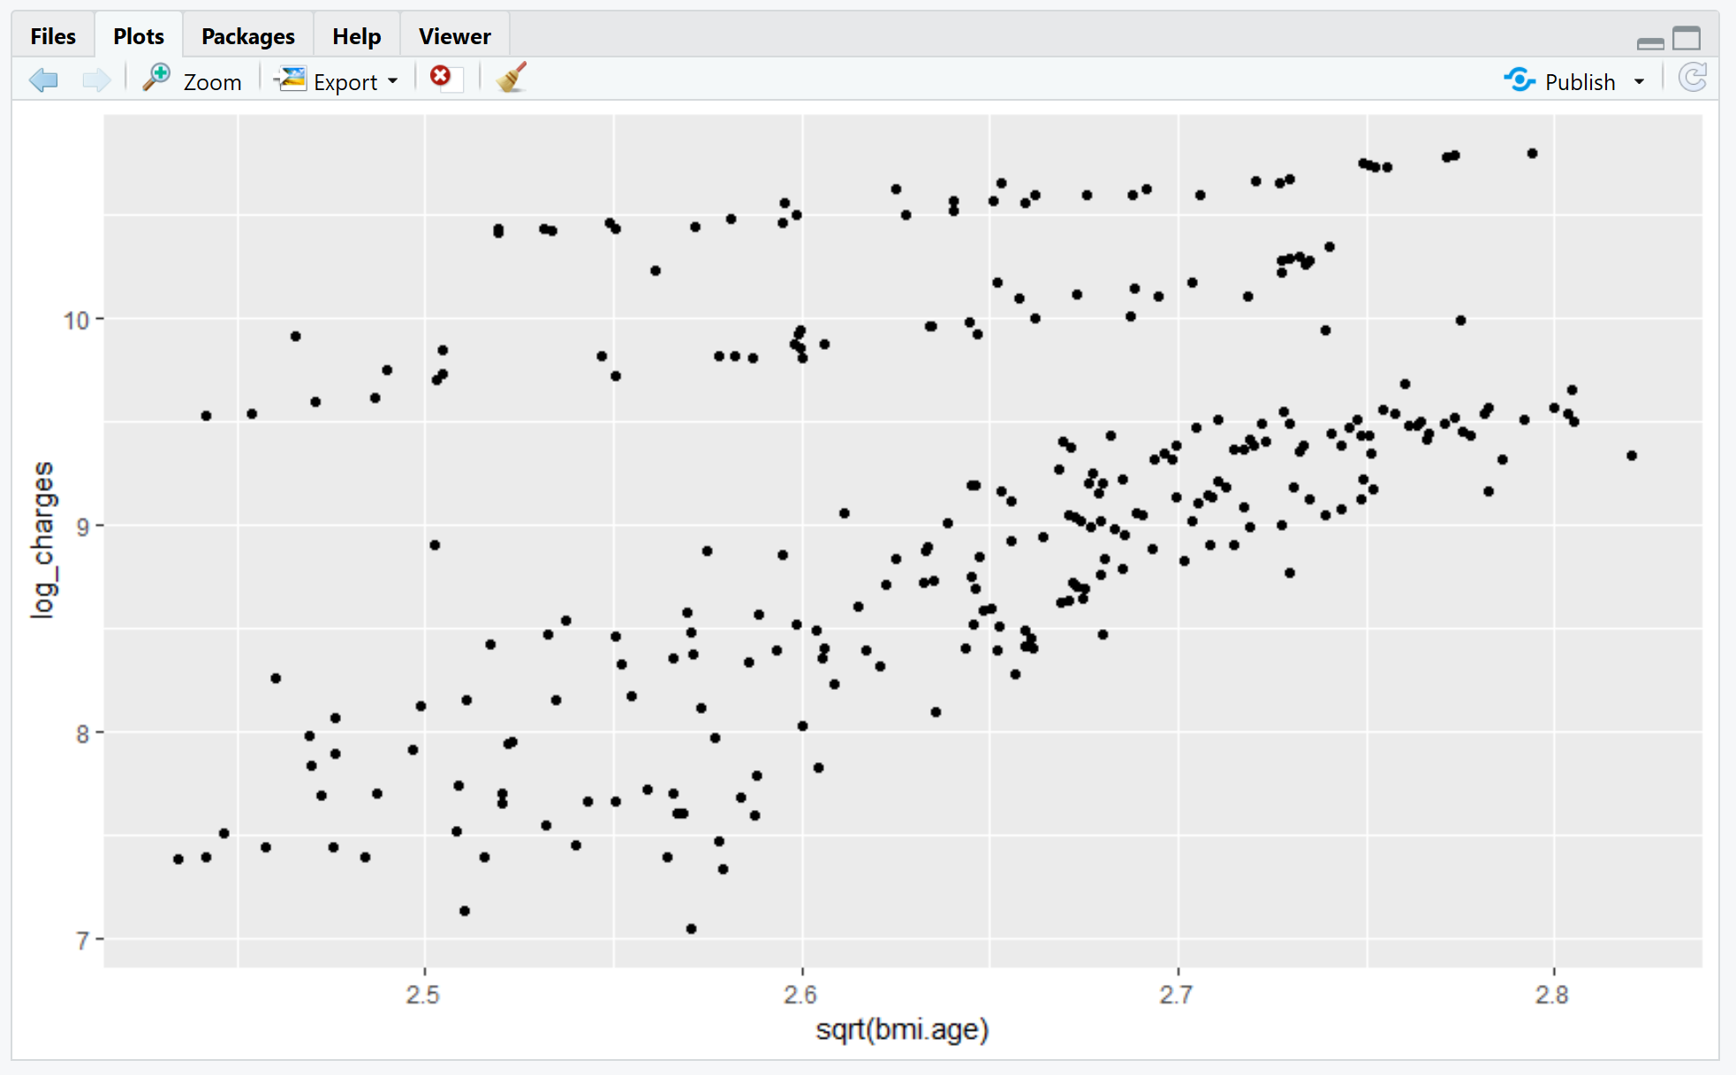
Solving for multi collinearity of Age and BMI - Test
BMI v/s insurance charge
Age v/s insurance charge
Taking square root of age and BMI
Multiplying age and BMI

Slide 23
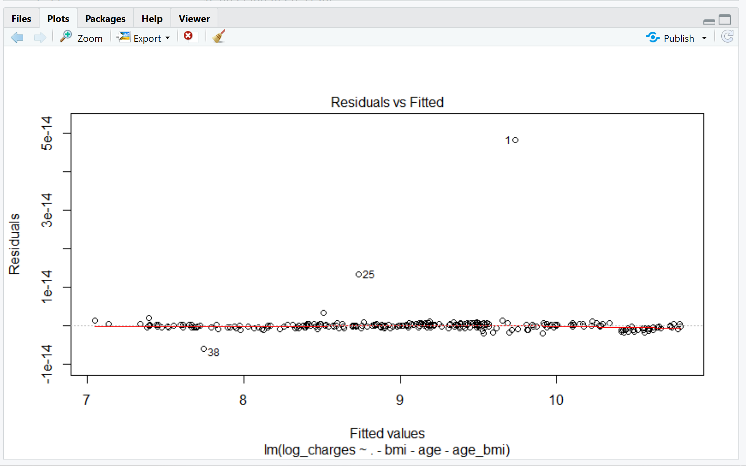
Final Model
Parameter | Value
Residual Standard Error | 3.209e-15
F-statistic | 2.156e+30
P-value | < 2.2e-16
RSE and p-value <<<< 0
F- statistic >>>> 0
Model is a perfect fit for the variables
There is a strong relationship between the dependent
and the independent variable.

Slide 24
Prediction Model
Name : Bob | Value
Age | 19
Sex | Male
BMI | 27.9
Children | 0
Smoker | yes
Region | northwest
Age_bmi | 0.982
Age.bmi | 6.4
Result | 9.600
Antilog of result | 14,750.09
Name : Tracy | Value
Age | 30
Sex | Female
BMI | 27.9
Children | 2
Smoker | yes
Region | northwest
Age_bmi | 0.982
Age.bmi | 6.40
Result | 8.721
Antilog of result | 6,124.76

Slide 25
Conclusion
The model helps in increasing the cost efficiency.
It reduces the risk of insurance fraud.
Time saving and easily operational.
Factors like age, BMI, smoking habits affect the charge of insurance premium.
Increase in age will lead to an increase in cost as with age, health complications increase.
Maintaining a healthy lifestyle is the best way to keep insurance costs as low as possible.

Slide 26
Applications of linear regression
Can be used in business planning to evaluate trends and make estimates or forecasts
To generate insights on consumer behavior and understand factors increasing profitability
To analyze the marketing effectiveness, pricing and promotions on sales of a product
To assess risk in financial services or insurance domain.

Slide 27
Predictive analytics in insurance sector
Helps understand and model the future behavior of their customers.
Map trends to keep the organization ahead of the market when predicting risk
Fraud detection by creating intricate predictive analytics models
Analytics platforms with easy-to-use visualization tools.
Real-time reporting across multiple devices.
FUTURE TRENDS

Slide 28
reference
BuinessWire. (2018). Analyzing the Impact of Health Insurance Analytics: Quantzig’s Take on How the Insurance Industry is Evolving in 2018. Retrieved from: https://www.businesswire.com/news/home/20181023005754/en/Analyzing-Impact-Health-Insurance-Analytics-Quantzig
Berchick, E., Hood, E., Barnett, J. (2018, September 12). Health Insurance Coverage in the United States: 2017. Retrieved from: https://www.census.gov/library/publications/2018/demo/p60-264.html
Analytics Vidhya Content Team, & Analytics Vidhya Content. (2017, January 31). Going Deeper into Regression Analysis with Assumptions, Plots & Solutions. Retrieved February 14, 2019, from https://www.analyticsvidhya.com/blog/2016/07/deeper-regression-analysis-assumptions-plots-solutions/
Bobs guide. (2018, July 24). Predictive analytics is key to insurance sector competitiveness. Retrieved from: https://www.bobsguide.com/guide/news/2018/Jul/24/predictive-analytics-is-key-to-insurance-sector-competitiveness/

Slide 29
Reference
Shitut, N. (2018, November 18). Popular Applications Of Linear Regression For Businesses. Retrieved from: https://analyticstraining.com/popular-applications-of-linear-regression-for-businesses/
Rego, F. (2015, October 23). QUICK GUIDE: INTERPRETING SIMPLE LINEAR MODEL OUTPUT IN R. Retrieved from: https://feliperego.github.io/blog/2015/10/23/Interpreting-Model-Output-In-R
Loginov, M., Marlow, E., Potruch, V. (2018). PREDICTIVE MODELING IN HEALTHCARE COSTS USING REGRESSION TECHNIQUES. Retrieved from: https://umanitoba.ca/faculties/management/academic_depts_centres/centres_institutes/warren/media/P2B_3_Michael_Loginov_Predictive_Modeling_Regression(3).pdf

Slide 30
ALY 6015 INTERMEDIATE ANALYTICS Q & A
FINAL PROJECT
FACTOR BEFITTING FOR INSURANCE CHARGES
INSTRUCTOR – Valeriy Shevchenko
NAME | EMAIL
SHIVI NIGAM | nigam.sh@husky.neu.edu
MIHIR GANDHI | gandhi.mih@husky.neu.edu
MAHITA KODURU | koduru.m@husky.neu.edu
RUCHI PARAB | parab.r@husky.neu.edu

